Slide 1
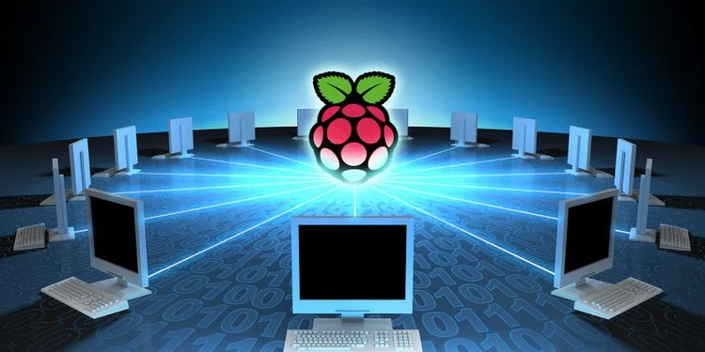
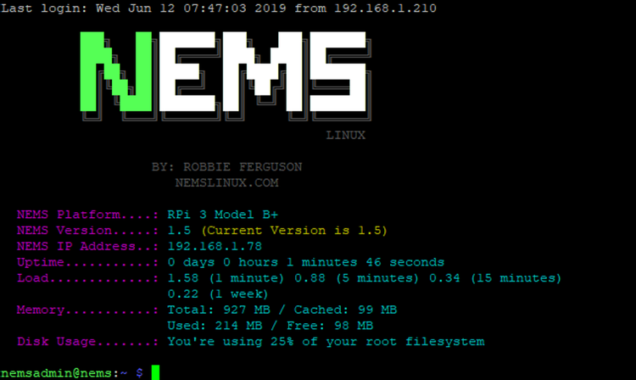
A simple network monitoring tool using a Raspberry Pi and NEMS to monitor network activity and connections.
PiDefender
Creator: Mason Dozier

